Slide 1
FILE ORGANIZATION IN DATABASE MANAGEMENT SYSTEM
DONE BY :-
NAME : ROHIT M
ROLL NO. : 49

Slide 2
Contents
What is a File?
What is File Organization?
The Objective of File Organization
Types of File Organizations
Sequential File Organization
Heap File Organization

Slide 3
What is a file ?
A file is a container in a computer system that holds data or information, stored in a digital format.
It is a collection of related information that is recorded on secondary storage such as magnetic disks, magnetic tapes, and optical disks.
Files can be of different types, depending on the kind of data they contain (e.g., text files, image files, audio files, video files).
Each file in a computer system is identified by a unique name and a file extension (e.g., .txt, .jpg, .mp3).
COMPONENTS OF A FILE :
Name
Extension
Content
Metadata

Slide 4
What is File Organization?
File organization is a logical relationship among various records. This method defines how file records are mapped onto disk blocks.
In simple terms, Storing the files in a certain order is called File Organization.
File organization is used to describe the way in which the records are stored in terms of blocks, and the blocks are placed on the storage medium.
The first approach to map the database to the file is to use the several files and store only one fixed length record in any given file. An alternative approach is to structure our files so that we can contain multiple lengths for records.
Files of fixed length records are easier to implement than the files of variable length records.

Slide 5
The Objective of File Organization
It has an ideal record selection, which means records can be selected as quickly as feasible.
Insert, delete, and update transactions on records should be simple and rapid.
Duplicate records cannot be created by inserting, updating, or deleting records.
Records should be stored efficiently to save money on storage.

Slide 6
Types of file organization
There are a variety of ways to organize your files. On the basis of access or selection, these methods offer advantages and disadvantages. The programmers choose the finest file organization strategy for their needs when it comes to file organization.
There are 6 types of FO methods :-
Sequential File Organization
Heap File Organization
Hash File Organization
B+ Tree File Organization
Clustered File Organization
ISAM (Indexed Sequential Access Method)

Slide 7
Sequential File Organization
The easiest method for file Organization is the Sequential method.
In this method, the file is stored one after another in a sequential manner.
There are two ways to implement this method:
Pile file method
Sorted file method

Slide 8
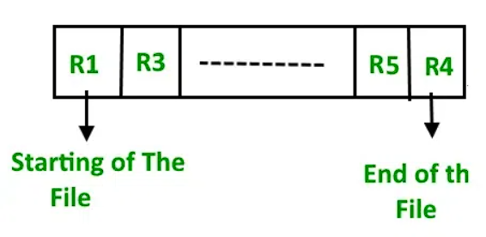
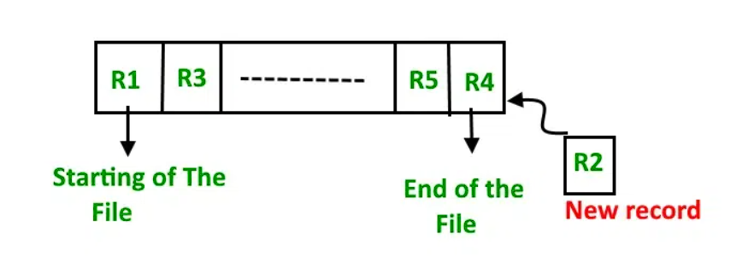
Pile File Method
We store the records in a sequence i.e. one after the other in the order in which they are inserted into the tables.

Slide 9
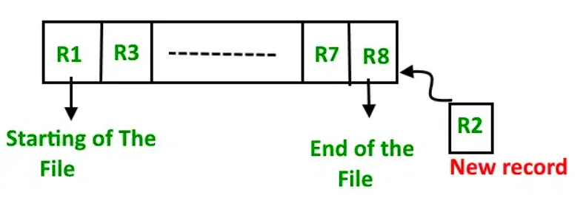
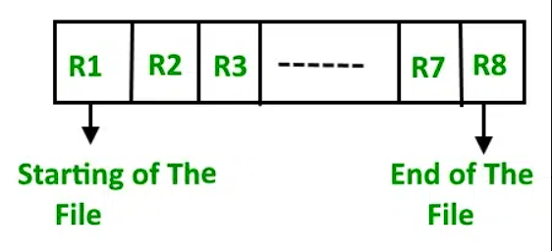
Sorted File Method
Whenever a new record has to be inserted, it is always inserted in a sorted manner (ascending or descending) .
The sorting of records may be based on any primary key or any other key.

Slide 10
Sequential File Organization
Advantages
Disadvantages
Fast and efficient method for huge amounts of data.
Simple design.
Files can be easily stored in magnetic tapes i.e. cheaper storage mechanism.
Time wastage as we cannot jump on a particular record that is required, but we have to move in a sequential manner which takes our time.
The sorted file method is inefficient as it takes time and space for sorting records.

Slide 11
Heap File Organization
Heap File Organization works with data blocks.
In this method, records are inserted at the end of the file, into the data blocks.
No Sorting or Ordering is required in this method.
If a data block is full, the new record is stored in some other block, here the other data block need not be the very next data block, but it can be any block in the memory.
It is the responsibility of DBMS to store and manage the new records.

Slide 12
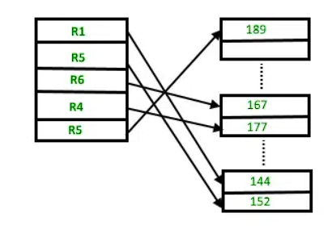
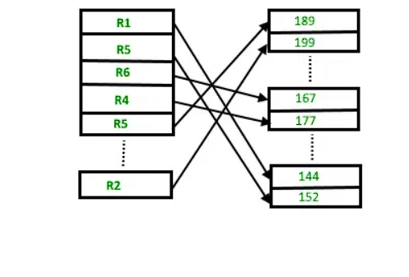
Suppose we have four records in the heap R1, R5, R6, R4, and R3, and suppose a new record R2 has to be inserted in the heap then, since the last data block i.e data block 3 is full it will be inserted in any of the data blocks selected by the DBMS, let’s say data block 1.

Slide 13
HEAP File Organization
Advantages
Disadvantages
Fetching and retrieving records is faster than sequential records but only in the case of small databases.
When there is a huge number of data that needs to be loaded into the database at a time, then this method of file Organization is best suited.
The problem of unused memory blocks.
Inefficient for larger databases.

Slide 14
Thank you

